Slide 1


MAJOR PROJECT ON PLANT DISEASE DETECTION USING ALEXNET MODEL
Under the guidance of
Mrs. Tapaswini Pattanaik
(Asst. Professor, Department of ECE)
Presented By – Saumya kant Baral
6th May 2024 Department of Electronics and Communication

Slide 2



CONTENTS
Introduction
Literature Review
Problem Statement
Motivation
Methodology
Result
Summary
Conclusion & Future Scope
References
6th May 2024 Department of Electronics and Communication

Slide 3


INTRODUCTION
Plant diseases and pests threaten agriculture and food security worldwide.
Early, precise detection is vital for effective management.
Deep learning, especially CNNs such as Alexnet, Resnet, etc, excels in identifying and classifying issues.
CNNs analyze plant images, differentiating between health and disease.
They also discern normal plants from those affected by pests.
6th May 2024 Department of Electronics and Communication

Slide 4

LITERATURE REVIEW
SL.NO | TOPIC NAME | AUTHORS/PUBLISHING JOURNAL | YEAR | METHODOLOGIES | ADVANTAGES | DISADVANTAGES
1. | A comprehensive review on detection of plant disease using machine learning and deep learning approaches | C Jackulin , S. Murugavalli Measurement: Sensors | 2022 | various machine learning and deep learning techniques are used to identify plant diseases by extracting features from images. | Improves plant disease detection, compares techniques, applies advanced models, and benefits agriculture. | Small datasets, overfitting risks, high computational demands, limited generalization,
2. | An advanced deep learning models-based plant disease detection: A review of recent research | Muhammad Shoaib, Babar Shah, Shaker EI-Sappagh, Akhtar Ali, Asad Ullah, Fayadh Alenezi, Tsanko Gechev, Tariq Hussain and Farman Ali Frontiers in Plant Science | 2023 | CNNs and machine learning are used to detect plant diseases and pests, addressing data and image quality issues. | Machine Learning and Deep Learning boost accuracy, enable early detection, improve efficiency, support generalizable models, provide accessible datasets, reduce costs, and transfer knowledge. | Exclusion of recent developments, Limited coverage of ML/DL techniques, Lack of comprehensive economic
3. | Resnet-based approach for Detection and Classification of Plant Leaf Diseases | Vinod Kumar, Hritik Arora, Harsh, Jatin Sisodia IEEE Xplore | 2020 | Used a plant disease image dataset, applied ResNet34 for classification, and outperformed other methods in terms of accuracy and precision. | Achieves superior disease classification accuracy and precision using ResNet34 on a diverse plant image dataset. | Incomplete dataset, overlooking real-world challenges, neglecting external factors, lack of real-world validation

Slide 5
SL.NO | TOPIC NAME | AUTHORS/PUBLISHING GOURNAL | YEAR | METHODOLOGIES | ADVANTSGES | DIADVANTAGES
4. | Detection of plant leaf diseases using image segmentatio n and soft computing techniques | Vijai Singh, A.K. Mishra Information Processing in Agriculture | 2017 | The process includes capturing plant leaf images, improving quality, masking green pixels, removing infected clusters, genetic algorithm segmentation, color feature extraction, and disease classification | Automated disease detection, early identification, efficiency, accuracy, versatility, and environmental friendliness. | Accuracy issues, prior knowledge required, limited disease coverage, symptom variation, optimization needs, and potential expansion to cover more diseases.
5. | Plant Disease Detection and Classification by Deep Learning—A Review | LILI LI , SHUJUAN ZHANG, AND BIN WANG IEEE Access | 2021 | Collection of diverse plant images, preprocess and augment the data, select a suitable deep learning model, train, validate, fine-tune, and deploy for plant disease detection | High accuracy, speed, scalability, non-invasive, automation, continuous learning. | Data dependency, limited generalization, computational resources, interpretability, vulnerability to environmental factors, complex initial setup
6th May 2024 Department of Electronics and Communication

Slide 6

PROBLEM STATEMENT
Increasing occurrences of plant diseases pose a significant threat to global food security, demanding swift and accurate detection methods.
Current plant disease detection methods lack the precision needed for early diagnosis, leading to delayed responses and increased crop damage.
Leveraging the power of AlexNet, an advanced deep learning model, offers a promising solution to enhance accuracy and speed in plant disease detection, thereby mitigating agricultural losses.
6th May 2024 Department of Electronics and Communication

Slide 7

MOTIVATION
Plant diseases may seriously threaten crops. Therefore, it is critical to identify them early so that we can take the necessary precautions.
One of the modern ways of diagnosing plant diseases is to classify images using an automated system depending on the illness.
AlexNet provides pretty good image categorization accuracy.
6th May 2024 Department of Electronics and Communication

Slide 8

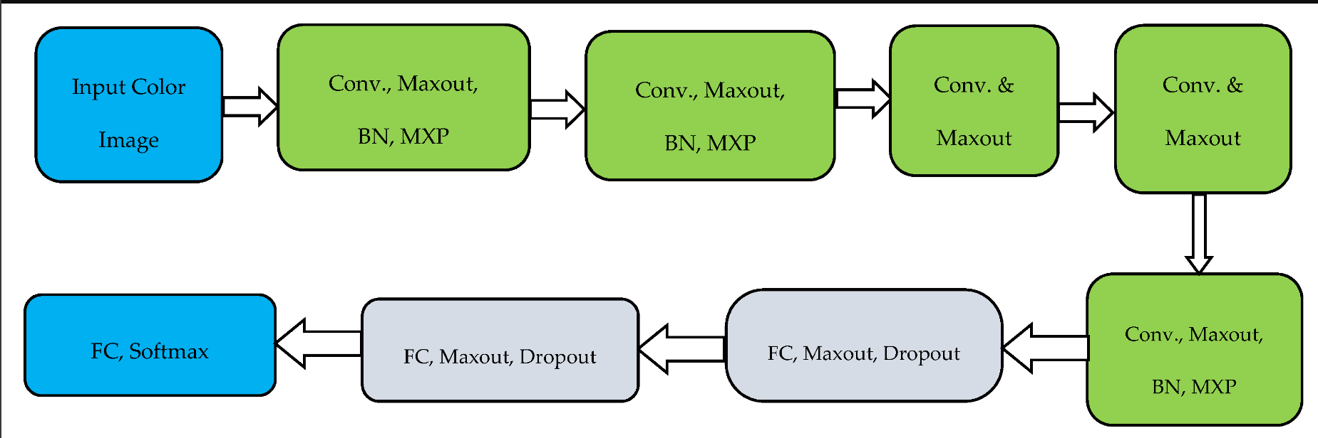
BLOCK DIAGRAM
Figure 1: AlexNet model classification of layers

Slide 9

METHODOLOGY
Using the AlexNet architecture for plant disease detection involves a multi-step process that includes data collection, preprocessing, model architecture setup, training, and evaluation.
AlexNet is a deep convolutional neural network (CNN) architecture that was originally designed for image classification tasks.
6th May 2024 Department of Electronics and Communication

Slide 10
Here's a general outline of the process:
Data Collection: Gather labeled images of healthy and diseased plant leaves, representing different diseases and health conditions.
Data Preprocessing: Resize images to a uniform size, normalize pixel values, and apply data augmentation for better model generalization.
Model Architecture: Set up AlexNet's architecture using a deep learning framework (e.g., TensorFlow or PyTorch). It includes convolutional and fully connected layers.
Model Training: Split data into training, validation, and testing sets. Train the model on the training set, using techniques like categorical cross-entropy loss and optimization (e.g., SGD, Adam).
6th May 2024 Department of Electronics and Communication

Slide 11
Model Evaluation: Assess the trained model's performance on the testing set, using metrics like accuracy, precision, recall, and F1-score to measure disease classification accuracy.
Fine-tuning: If needed, adjust hyperparameters, architecture, or use transfer learning by starting with a pre-trained model and adapting it to your dataset.
Deployment: Once satisfied, deploy the model in real-world scenarios, like apps, websites, or IoT devices, allowing users to upload images and get disease predictions.
6th May 2024 Department of Electronics and Communication

Slide 12

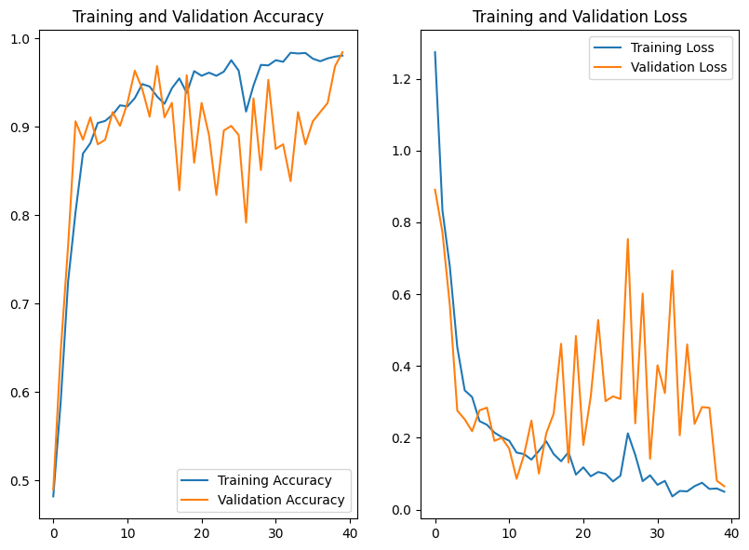
Result Analysis Of AlexNet
X-axis = Epoch
Y-axis = Accuracy
X-axis = Epoch
Y-axis = Accuracy
Figure 4: Graph of Training and Validation Accuracy
Figure 5: Graph of Training and Validation Loss
6th May 2024 Department of Electronics and Communication

Slide 13
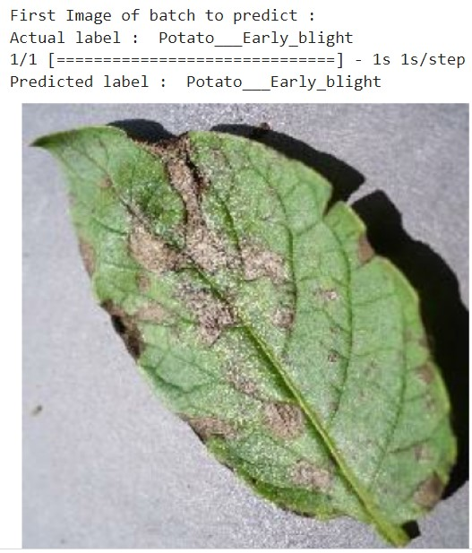
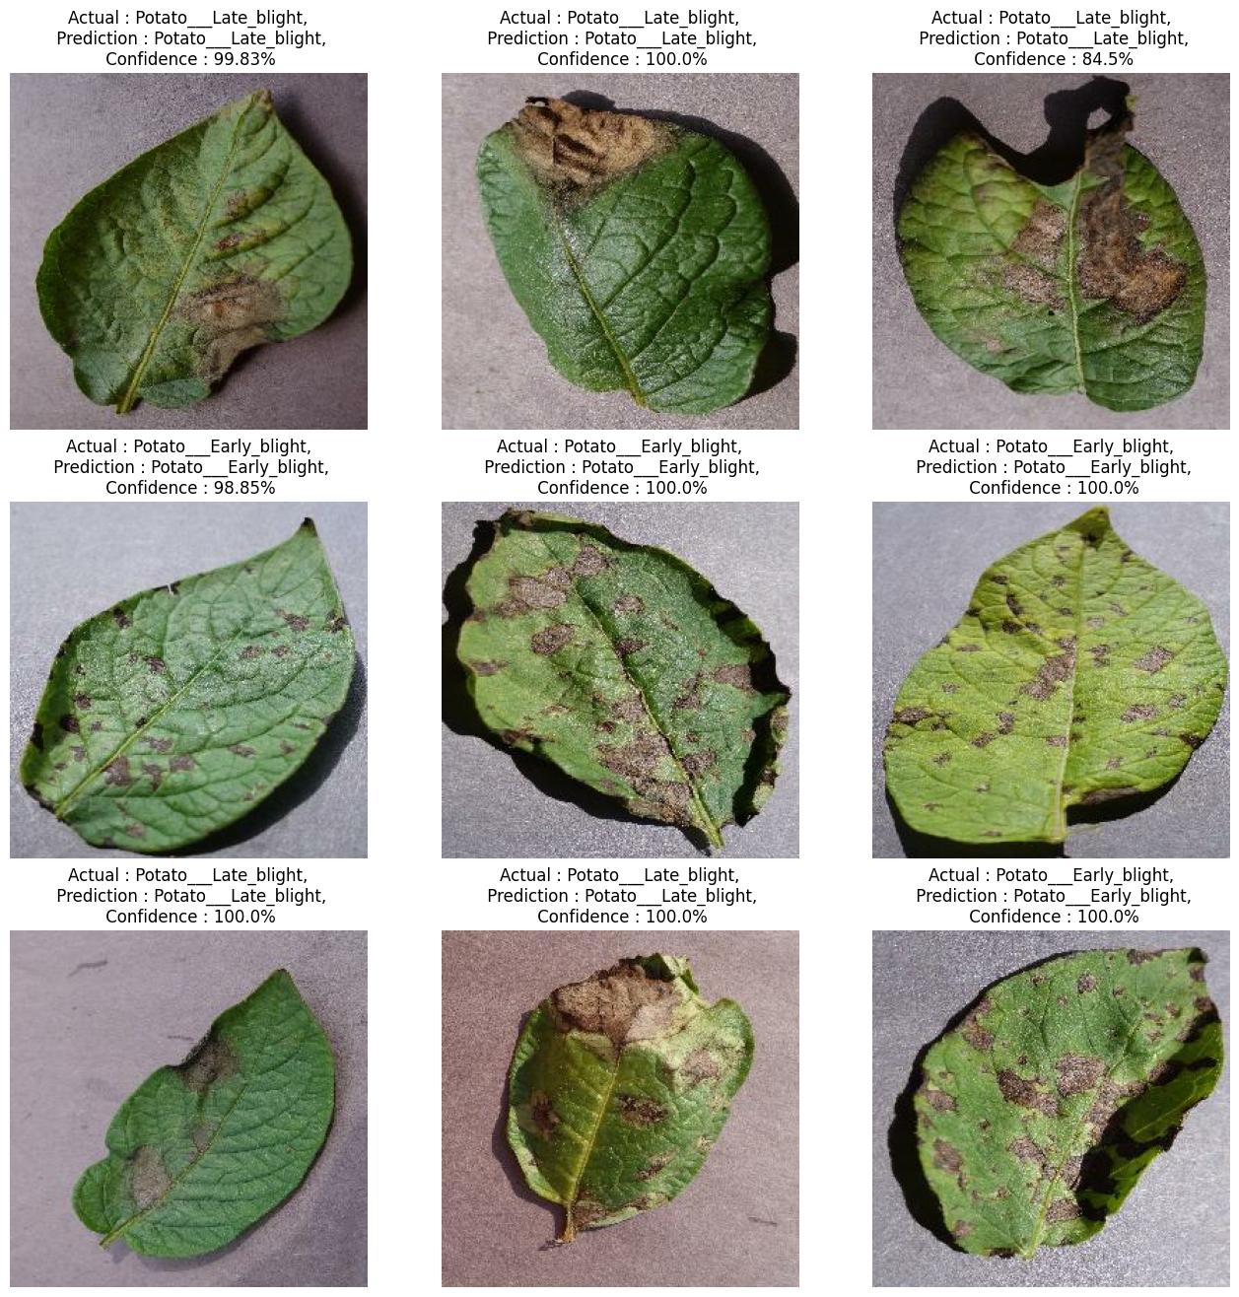
Figure 2: A Testing Image
Figure 3: results outputs of trained dataset
6th May 2024 Department of Electronics and Communication

Slide 14
MODEL | ACCURACY | LOSS
ALEXNET | 96% | 0.53%
We used a KAGGLE dataset OF 2152 potato leaf images.
We observe that AlexNet achieved 96% accuracy and loss is 0.53% in 40 epochs .
6th May 2024 Department of Electronics and Communication

Slide 15

SUMMARY
The AlexNet architecture for plant disease detection involves training a deep convolutional neural network to learn relevant features from plant leaf images and classify them as healthy or diseased.
This approach demonstrates the application of deep learning in agricultural contexts to aid in early disease detection and crop management.
6th May 2024 Department of Electronics and Communication

Slide 16
FUTURE WORK
CONCLUSION
Hence from the above proposed method we have presented model for automatic classification of plant disease classification on Alex Net and CNN.
The proposed model was based on Convolutional Neural Network architecture. We deployed Alex Net, a convolutional neural network, as the encoder to encode an image into a compact representation as the graphical features.
In future work, it would be beneficial to train AlexNet models with a larger dataset containing more diseases and crops.
An increase in dataset size can be achieved by adding more images as data points to enable the network to identify and classify a wider range of diseases and plant species.
6th May 2024 Department of Electronics and Communication

Slide 17

REFERENCES
C Jackulin, S. Murugavalli. A comprehensive review on detection of plant disease using machine learning and deep learning approaches. Measurement: Sensors (2022).
Muhammad Shoaib, Babar Shah, Shaker EI-Sappagh, Akhtar Ali, Asad Ullah, Fayadh Alenezi, Tsanko Gechev, Tariq Hussain and Farman Ali. An advanced deep learning models-based plant disease detection: A review of recent research. Frontiers in Plant Science (2023).
Vinod Kumar, Hritik Arora, Harsh, Jatin Sisodia. Resnet-based approach for Detection and Classification of Plant Leaf Diseases. IEEE Xplore (2020).
Vijai Singh, A.K. Mishra. Detection of plant leaf diseases using image segmentation and soft computing techniques. Information processing in agriculture (2017).
LILI LI, SHUJUAN ZHANG , AND BIN WANG. Plant Disease Detection and Classification by Deep Learning—A Review. IEEE Access (2021).
6th May 2024 Department of Electronics and Communication

Slide 18


THANK YOU
6th May 2024 Department of Electronics and Communication

